Slide 1
Airline Reservation System
Projected
By
Mohammed Haasan

Slide 2
Contents:
Introduction
Abstract
Objectives
Flow chart
Modules
Conclusion
Github

Slide 3
Introduction:
The airline reservation system is a web-based booking solution that helps in consolidating data from all airlines through the use of global distribution systems.
The system provides inventory and rates in real time to customers .

Slide 4
Abstract:
Airline reservation System is a computerized system used to store and retrieve information and conduct transactions related to air travel.
The project is aimed at exposing the relevance and importance of Airline Reservation Systems. It is projected towards enhancing the relationship between customers and airline agencies through the use of ARSs.

Slide 5
Objectives:
To make air ticket reservation easier for passenger
To save time and effort of potential air traveler
To develop a program code of simple airline reservation system.

Slide 6
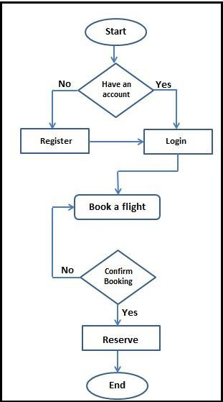
Flow chart:
Basic Diagram of Reservation System

Slide 7
Modules
Home
Register
Login
Booking

Slide 8
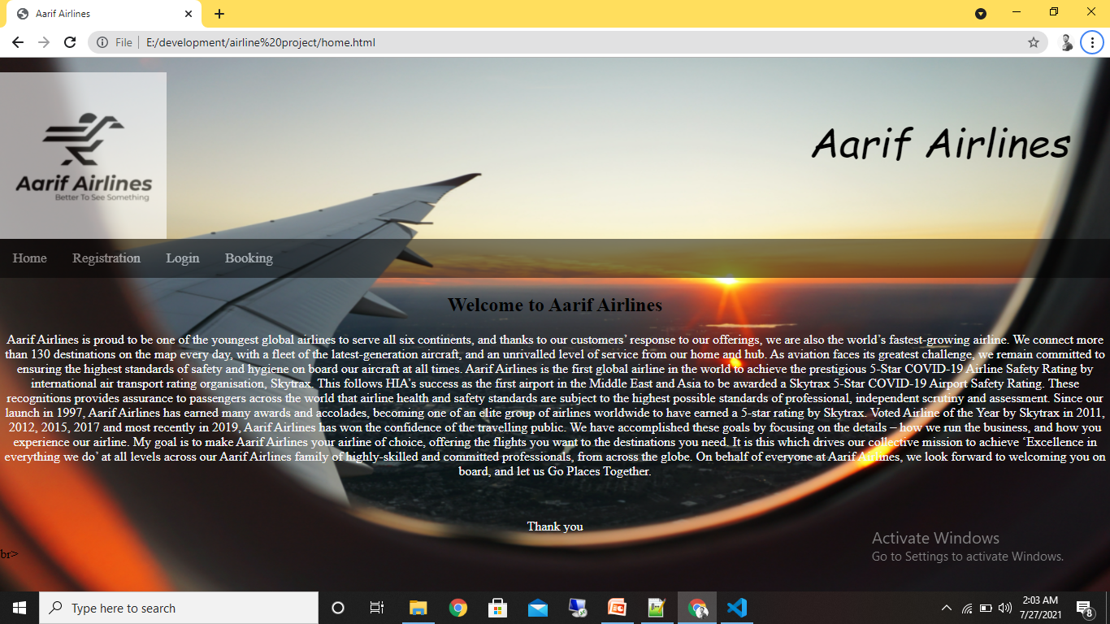
Home

Slide 9
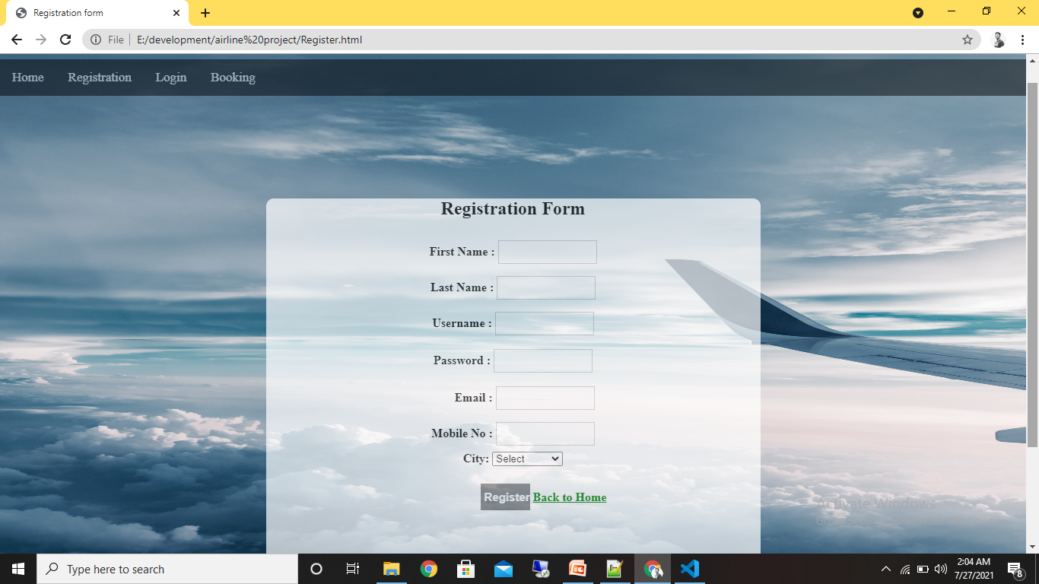
Registration

Slide 10

Login

Slide 11
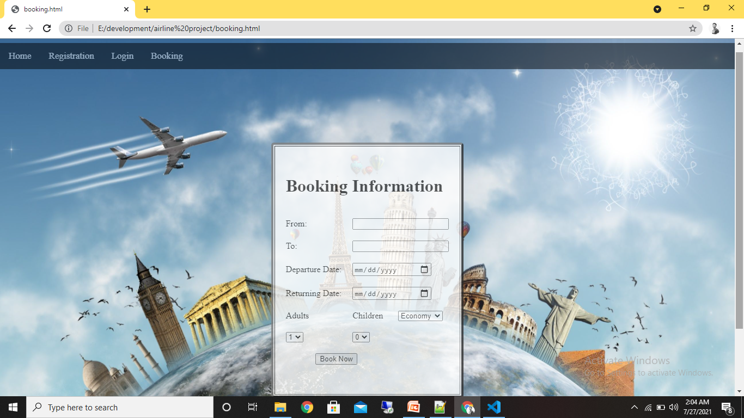
Booking

Slide 12
Conclusion:
It not only provides flight details but also but also creates a platform to book tickets, cancels or modifies ticket timings or dates and even informs about the number of people on board!

Slide 13
Github:
“https://github.com/mohammedhaasan/Aarif.git “

Slide 14
Thank You!

